Slide 1
Privacy-Preserving Natural Language Processing: A Systematic Mapping Study
Felix Jedrzejewski, 08.03.2021, Master Thesis Kick-Off Presentation

Slide 2
Outline
Introduction
    Background
    Motivation
    Thesis’ Goals
Research Questions
Methodology
Current Results
Next Steps
Timeline

Slide 3

Background – Is Privacy really an Issue nowadays?
      There are 26 key privacy issues affecting the consumer:
Medical Records Confidentiality
Big Data
Key Privacy Issues
Internet of Things
Online Privacy and E-commerce
Information Broker Industry
…
For more information, visit Privacy Today: A Review of Current Issues
Picture from privacyrights.org

Slide 4
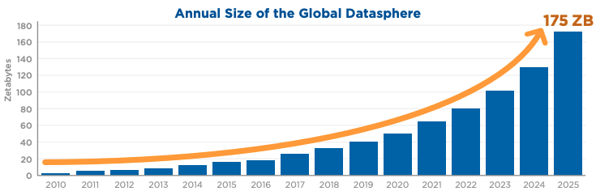
Background – Why is it so hard to keep data private?
1 Zetabyte = 10^21 Bytes
[Ryd18] Rydning, David Reinsel–John Gantz–John: "The digitization of the world from edge to core." Framingham: International Data Corporation (2018).

Slide 5
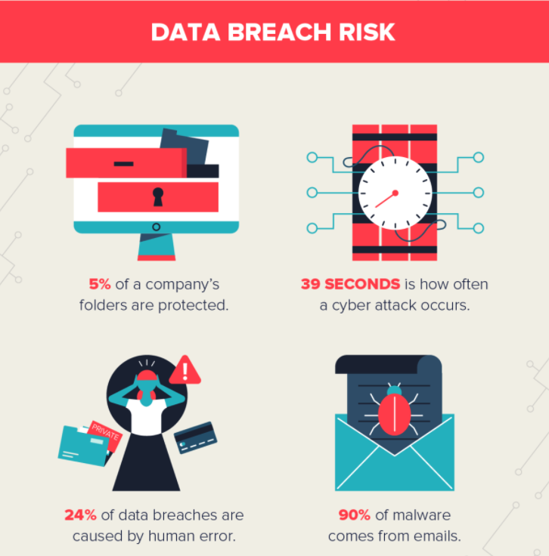
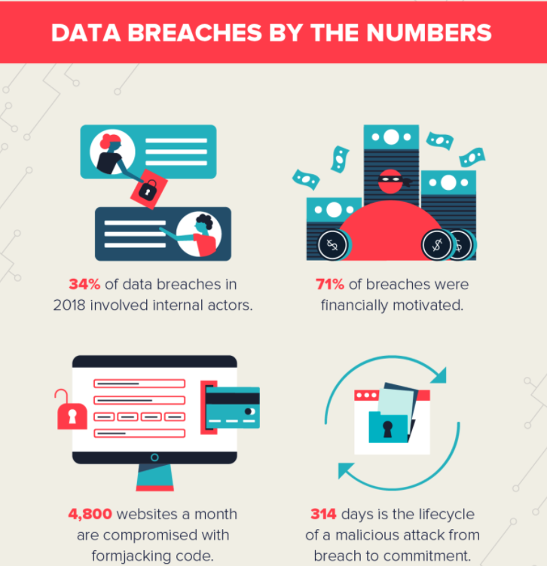
Background – Is my Privacy safe in the hands of companies I trust?
Both images taken from Varonis’ post 107 Must-Know Data Breach Statistics for 2020

Slide 6
Motivation – Why do we need Privacy Preserving NLP?
Current techniques to establish privacy face two limitations:
  High possibility of attacks with background knowledge about the released data
  Decrease of data utility
Frequently used word embeddings as a threat to privacy
  E.g. Word embeddings deidentified by removing personal health information (PHI) still 68% exploitable¹
High risk of re-identification attacks of published unstructured Big Data sets
Lack of mechanisms to support organizations to protect data subjects (person addressed by the data)
Protection of user privacy in untrusted digital environments
…
^{1[}Abd20]Abdalla, M; Abdalla, M; Hirst, G; Rudzicz, F: Exploring the Privacy-Preserving Properties of Word Embeddings: Algorithmic Validation Study
[Pa18]Park, Noseong; Mohammadi, Mahmoud; Gorde, Kshitij; Jajodia, Sushil; Park, Hongkyu; Kim, Youngmin: Data Synthesis based on Generative Adversarial Networks
[Me19]Mehta, B; Rao, UP; Gupta, R; Conti, M: Towards privacy preserving unstructured big data publishing
[Lo17 ]Lopez-Otero, Paula; Magariños, Carmen; Docio-Fernandez, Laura; Rodriguez-Banga, Eduardo; Erro, Daniel; Garcia-Mateo, Carmen: Influence of speaker de-identification in depression detection

Slide 7
Motivation – Where can we use NLP to preserve Privacy?
Medical Context
  Prevention of Data Disclosure: Removing privacy related data from the medical record of person A (like other diseases, name, age, gender) which is used as training data for a ML model and can be retrieved by a malicious user
Legal Context
  Privacy Compliance: Striping of privacy related information from (training) data sets (medical records, consumer data etc.) that are about to be published for any kind of purpose without violating privacy rights
Social Media Context
  Privacy Awareness: Protecting sensitive information on social media platforms (e.g. User wants to post his local address, with NER these pieces of information are tagged as “private” and the user will be warned)

Slide 8
Use Case 1
BUT: Company A does not want to disclose the data fully to Company B
MLaaS
Company B
Client Data
Company A
Client Data
[Po20] Podschwadt, Robert, and Daniel Takabi. "Classification of Encrypted Word Embeddings using Recurrent Neural Networks." PrivateNLP@ WSDM. 2020.

Slide 9
Use Case 2
Privacy Preserving NLP Framework notifies user about private or sensitive data disclosure
”Hi my name is Max Mustermann and I live in 12345 Musterstadt!”
Posts
Max Mustermann
Social Media Platform
(e.g. Facebook, Twitter etc.)
PP NLP Framework
alerts
Disclosure of private Information
Warning
[Me20] Mehdy, AKM Nuhil, and Hoda Mehrpouyan: "A User-Centric and Sentiment Aware Privacy-Disclosure Detection Framework based on Multi-input Neural Network." PrivateNLP@ WSDM. 2020.

Slide 10
Thesis’ Goals
  Propose a definition of Privacy-Preserving NLP
  Summarization of the current state of Privacy-Preserving NLP
  Categorization of current Privacy-Preserving NLP approaches
  Pointing out the trends in Privacy-Preserving NLP
  Identification of gaps in current research to propose areas for further investigation.

Slide 11
Research Questions
  RQ1: What privacy-related challenges exist in the area of Natural Language Processing (NLP)?
  RQ2: What approaches are used to preserve privacy in NLP tasks and how can they be classified?
  RQ3: What are the current research gaps and possible future research directions in the area of privacy-preserving NLP?

Slide 12
Research Questions
  RQ1: What are the main challenges of privacy in NLP?
  RQ2: What are current approaches for privacy preserving NLP and how can they be classified?
  RQ3: Where are privacy preserving NLP techniques already used in the industry?
  RQ4: Which gaps are there in privacy preserving NLP research area?
  (RQ5: Which platforms were used to publish privacy preserving NLP?)
[Hei14] Heinz, Marcel: "Systematic Mapping Studies." Mainz: Universität Koblenz-Landau (2014).

Slide 13
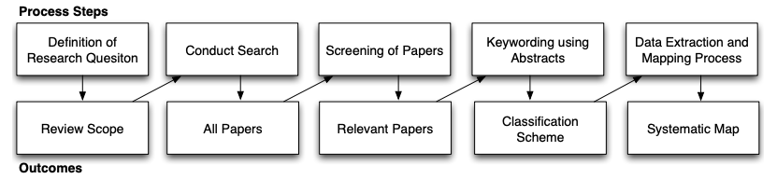
Methodology – Systematic Mapping Study
Figure taken from [Pe08] Petersen, K., Feldt, R., Mujtaba, S., & Mattsson, M. (2008, June). Systematic mapping studies in software engineering. In 12th International Conference on Evaluation and Assessment in Software Engineering (EASE) 12 (pp. 1-10).
Notes:
Search query through data bases.

Slide 14
Current Results - Searching
  Used Search Queries (so far)
    "Privacy Preserving" AND ("Natural Language Processing” OR NLP)
    (''Privacy Enhancing'' OR ''Privacy Guaranteeing'') AND ("Natural Language Processing” OR NLP)
  Research Databases
    IEEE Xplore
    ACM Digital Library
    Google Scholar
    ScienceDirect
    Springer
    Scopus
    Wiley
    Web of Science
    Google (for grey literature)
Notes:
Search query through data bases.

Slide 15
Current Results – Inclusion / Exclusion Criteria
Inclusion | Exclusion
NLP related Task used to establish privacy | Not English
NLP supported a process to establish privacy | Mathematical alteration of deep learning or machine learning concepts
NLP task altered for privacy purposes | No NLP domain applied
Notes:
Search query through data bases.

Slide 16
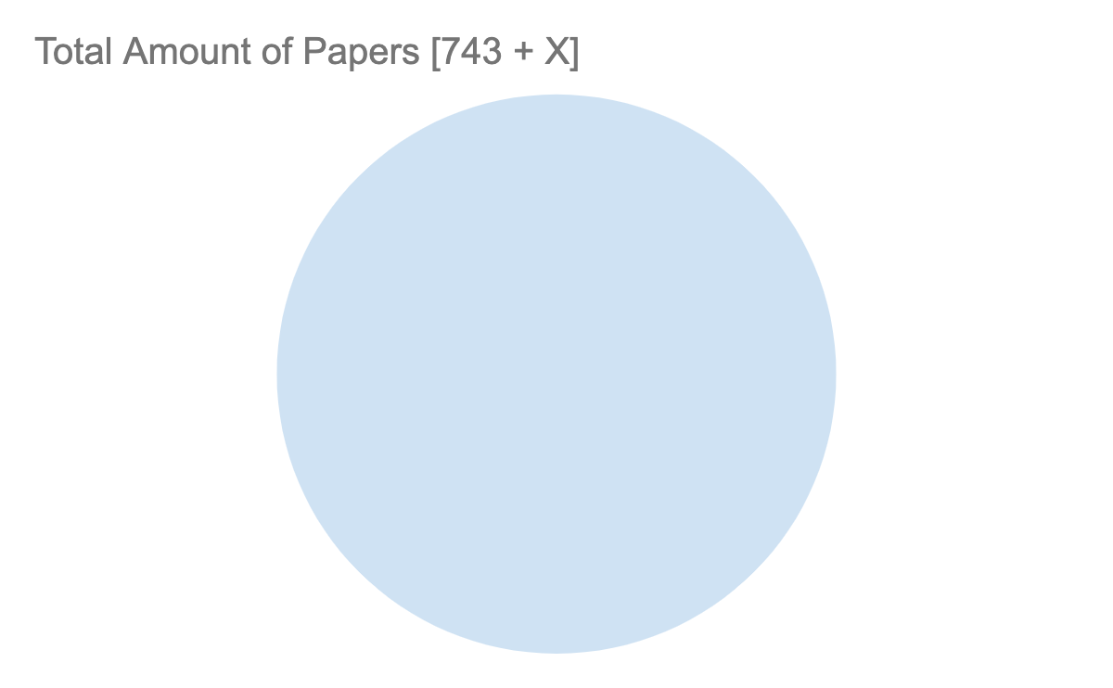
Current Results - Statistics
Notes:
Search query through data bases.

Slide 17
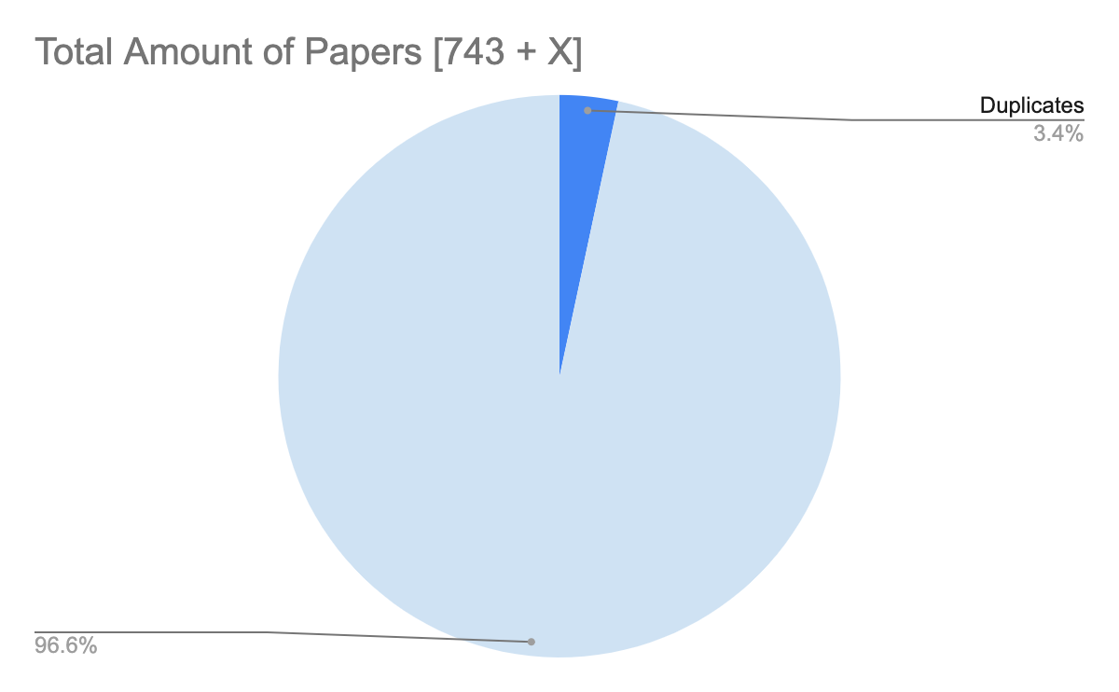
Current Results - Statistics
Notes:
Search query through data bases.

Slide 18
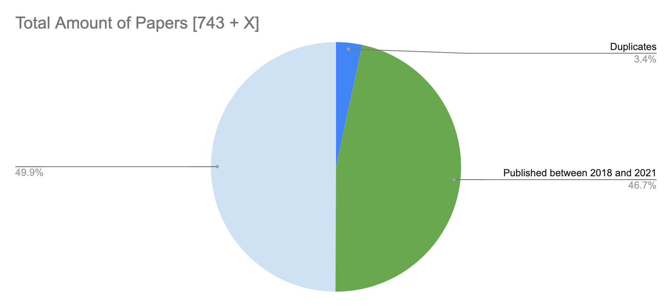
Current Results - Statistics
Notes:
Search query through data bases.

Slide 19
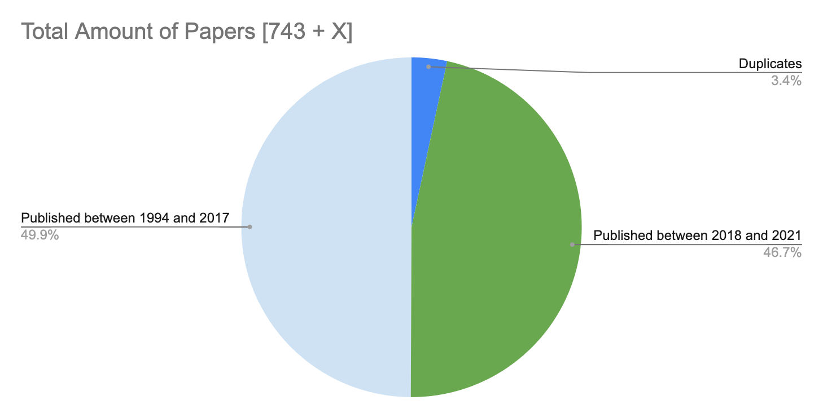
Current Results - Statistics
Notes:
Search query through data bases.

Slide 20
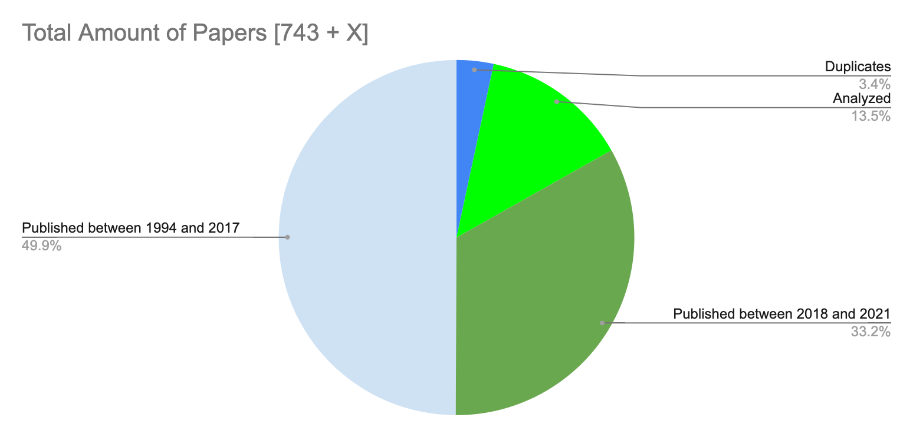
Current Results - Statistics
Notes:
Search query through data bases.

Slide 21
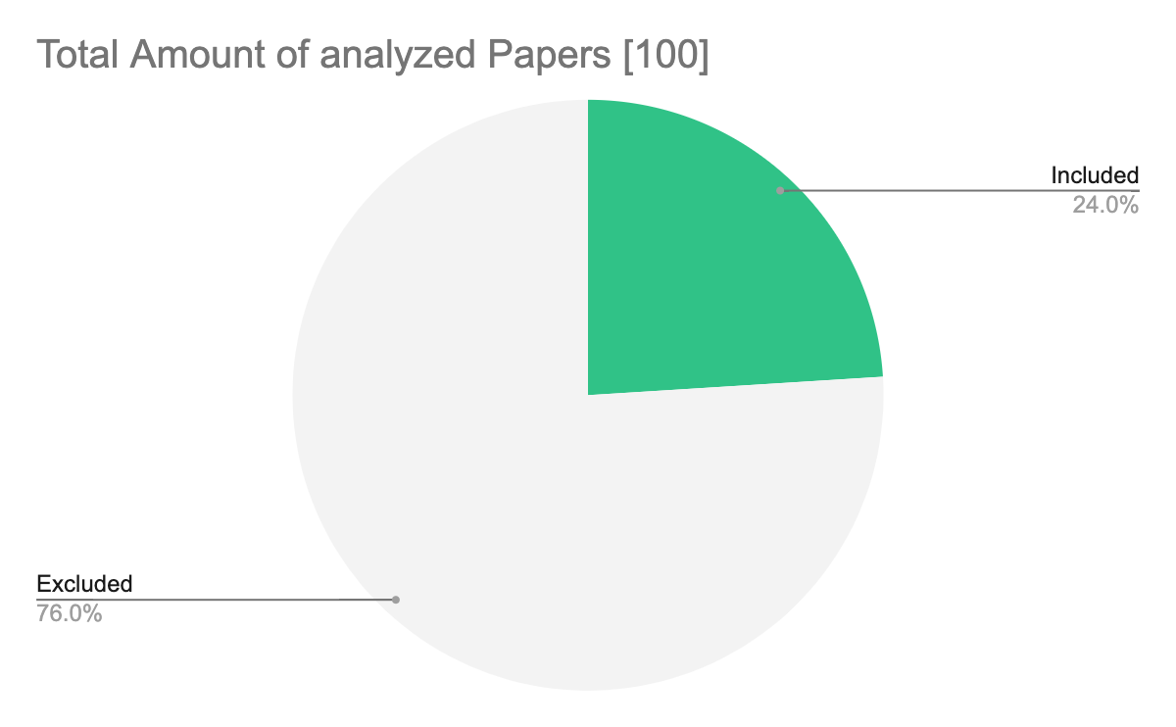
Current Results - Topics
Notes:
Search query through data bases.

Slide 22
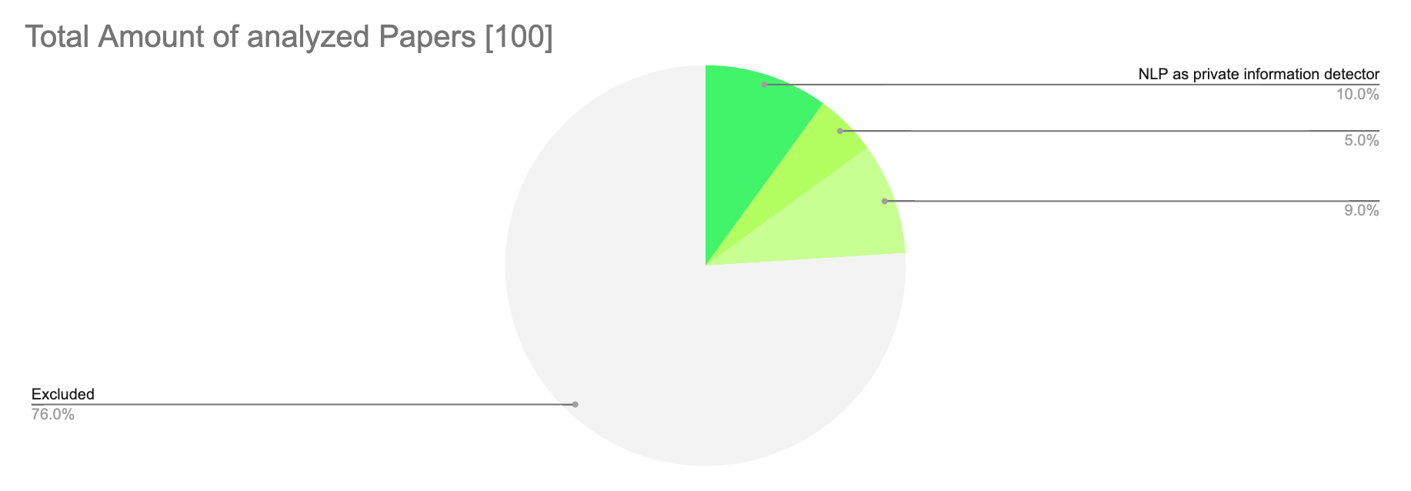
Current Results - Topics
Notes:
Search query through data bases.

Slide 23
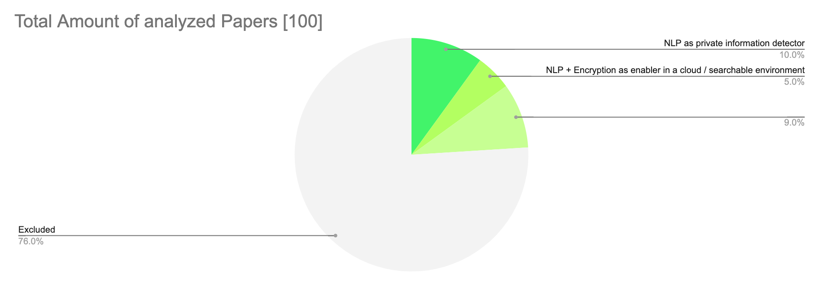
Current Results - Topics
Notes:
Search query through data bases.

Slide 24
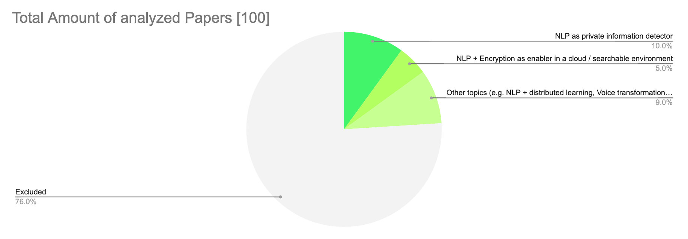
Current Results - Topics
Notes:
Search query through data bases.

Slide 25
Next Steps
  Searching for more grey literature
    Google (for grey literature)
  More search queries in the pipeline
    (Private OR Privacy) AND (NLP OR "Natural Language Processing")
    ("Privacy Preserving” OR Private OR Privacy) AND ”Word Embeddings”
    (''Privacy Enhancing'' OR ''Privacy Guaranteeing'' OR "Privacy Preserving" OR Private OR Privacy) AND ("Speech Recognition" OR "Speech Segmentation" OR "Text-to-Speech" OR "Automatic Summarization" OR "Machine Translation" OR "Natural Language Generation" OR "Natural Language Understanding" OR "Question Answering")
  Continue with analysis of the relevant sources
Notes:
Search query through data bases.

Slide 26
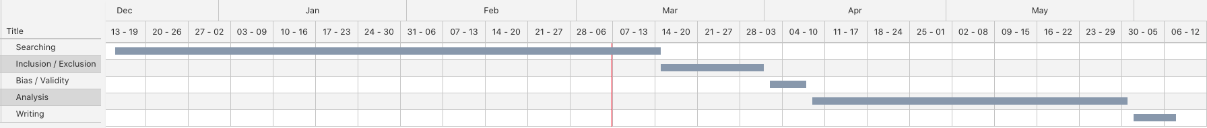
Timeline
We are here!
proudly made with the Gantt Chart Tool of VisualParadigm

Slide 27
    Thanks for your attention!

Slide 28
    Backup Slides

Slide 29
Approaches
Secure Data Processing: de-identification
  Using Named Entity Recognition to find and/or remove identifiers in data (e.g. diagnosis reports or clinical trial reports)
Homomorphic Encryption and NLP
  Execution of NLP over encrypted private data without revealing it
  Enabling companies to apply MLaaS without private data disclosure
Privacy (and utility) preserving hierarchical representations in text
  Word Representations in hyperbolic spaces
Differential Privacy
  Development of a differential private protocol to communicate with untrusted servers
Medium Blog Post: Differentially Private Natural Language Processing
Notes:
Data used for training can be reverse engineered
ML for health diagnosis shouldn’t memorize the name of a patient (or other privacy sensitive data)

Slide 30
Title Suggestions
    Identification of Current Privacy Preserving Natural Language Processing Fields/Domains/study topics: A systematic Mapping Study
    Investigating Current Privacy Preserving Natural Language Processing Domains/Fields/Trends: A systematic Mapping Study
    Privacy-Preserving Natural Language Processing: A Systematic Mapping Study
    Investigating Trends in Privacy Preserving Natural Language Processing (etc, without "systematic mapping study" in the end)
Medium Blog Post: A Brief Overview of Privacy-Preserving Software Methods

Slide 31
Privacy Preserving Software Methods
    Symmetric Encryption
      E.g. AES, DES
    Asymmetric Encryption
      E.g. RSA
    Homomorphic Encryption
      Executing Computations in an encrypted way on an untrusted third party
    Differential Privacy
      Learning about an population within a dataset or aggregated datasets without exposing explicit information about an individual
    Secure Multi-Party Computation
      Multiple parties having pieces of an information for a particular function without disclosing its piece of information to the other parties
Medium Blog Post: A Brief Overview of Privacy-Preserving Software Methods

Slide 32
Current Results – detailed Topics
In total: 100 papers analyzed
  NLP used for private information tagging / extracting (NER) 10
  NLP + Crypto for privacy in cloud / searchable environment 5
  Using machine translation to obfuscate authorship 1
  NLP to create data synthetically 2
  NLP + Transfer / Federated Learning to avoid data sharing, thus privacy violations 2
  Automatic summarization of privacy policies 1
  Privacy experiment with three different word embeddings 1
  Privacy NER experiment with different NLP libraries 1
  NLP for structuring of big data sets 1
  De-identification with voice transformation 2
    Working with neurons without transcription of spoken text (implicit privacy)
  Building NLP-based DP protocols 1
  Introduction of noise to vector representations to generalize location data 1
  Introduction of user-conditioned randomness to email messages with inference tasks 1
  24 papers relevant for us….
Notes:
Search query through data bases.

Slide 33
Examples for Privacy Preserving Natural Language Processing
    Using Homomorphic Encryption to execute search actions on cloud data in a privacy preserving way
    Neuronal machine translation using privacy preserving Long Short Term Memory Network (PrivLSTM) + Sequence to Sequence transformation (PrivSEQ2SEQ)
    → Avoidance of information leakage about other parties
[Thi16]Thilagam, T.: PRIVACY PRESERVING NATURAL LANGUAGE PROCESSING IN THE CLOUD SUPPORTING SIMILARITY BASED TEXT RETRIEVAL THROUGH BLIND STORAGE.
[Fe20] Q. Feng, D. He, Z. Liu, H. Wang and K. R. Choo, "SecureNLP: A System for Multi-Party Privacy-Preserving Natural Language Processing,"

Slide 34
Research Outline
  Introduction
    Definitions
    Related Work
  Research Design
  Privacy Preserving NLP techniques used in the industry
  Directions of Privacy Preserving NLP
  Challenges of Privacy Preserving NLP
  Potential Research Gaps in Privacy Preserving NLP
  Conclusion
[Ga20] Gahan, Courtney: ”Research paper outline." www.scribbr.com

Slide 35
Stick to the good sebis traditions
  Provide action links at the bottom of the slide to guide the audience to our web pages or publications (see below). (Select the text, press CTRL-K)
  Use a file name according to our sebis conventions which helps us and our audience to find the file of your presentation on our web site with Google search:
    YYMMDD Author Short Title
    Include this string in the footer (Einfügen -> Kopf- und Fusszeile -> Fusszeile)
    The unusual date format simplifies the search for the latest version of a slide in an alphabetical directory listing (Dropbox, Explorer, Tricia, Sky-Drive)
[Ha13g]Hauder, M., Roth, S., Matthes, F.: Current Tool support for Metrics in Enterprise Architecture Management
For more information visit BEAMS , EAM Pattern Catalog and EAM KPI Catalog (http://wwwmatthes.in.tum.de)

Slide 36
Use the sebis visual language
(shapes, fonts, colors, sizes)
Default
Line Style
Default Rectangle
Default
Rounded R.
Text
Default
Text
User
Store
Information
Arrow
Cloud
Process
Box
Explanation
Fast
Form 1
Fast
Form 2
Fast
Form 3
Fast
Form 4
Fast
Form 5
Fast
Form 6
Fast
Form 6
Fast
Form 1
Fast
Form 2
Fast
Form 3
Fast
Form 4
Fast
Form 5
Fast
Form 6
Fast
Form 6

